Slide 1

Work Study and Loans 12th Grade
Learning Target: The students will know how to apply for loans and work study opportunities at postsecondary institutions.

Slide 2

Last Time . . .
In the last session you learned about grants and scholarships—two ways that students can help pay for postsecondary education.

Slide 3

Today . . .
Today we will focus on two additional ways students pay for college--federal work study and federal loans.

Slide 4
Work Study
Work study basically means having a job at college that is attached to your financial aid package.
Specific jobs are designated for work study students, although students may have to apply and can choose among different types of jobs.

Slide 5

Work Study Basics
Work study allows students to earn money for working at college. Many students use this money toward tuition.
Students often are too busy at their job to study. However, some jobs allow students to study while working.
Students may be able to get a job related to their major which is very good for growth, networking, and their resume.

Slide 6

Video: Opportunity to Learn
Click on the image to access the video

Slide 7

Video: Work Study at CUNY
Click on the image to access the video
While watching the video, record one thing you learned about federal work study and be prepared to share it.

Slide 8
Whole Group Dialogue
What was one thing you learned about federal work study?

Slide 9
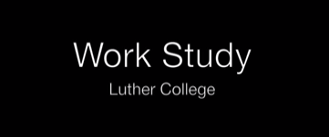
Video: Luther College – Work Study
While watching this video listen for the answers to two questions and be prepared to share what you heard:
1) What did the students say was valuable about their jobs?
2) How can work study strengthen your future career options?
Click on the image to access the video

Slide 10

Whole Group Dialogue
What did the students say was valuable about their jobs?
How can work study strengthen your future career options?

Slide 11

Review: Work Study
What kinds of jobs did the featured students do on campus for federal work study?
Student coordinator for cafeteria to community program—provide extra cafeteria food for food pantries in the town
Athletic training—rehabbing athletes
Photographer—take pictures at campus events or of places on campus
Radio broadcasting—broadcast campus events

Slide 12
Review: Work Study
How can work study strengthen your future career options?
May allow you to see varied types of work that relate to your interests
Helps students improve skills that relate to their career interests
Might help students decide if they should go on to graduate school
The jobs students do can go on their resumes, making them more attractive candidates for positions after college

Slide 13
Loan Basics
A bank or college provides a student a specific sum of money, or loan, and the student (and/or family) signs a legal agreement to pay it back over a specified amount of time.
Loans can be a reasonable way to cover part of college costs, but they have to be paid back with an additional amount of interest, so it is very important to know the facts.

Slide 14
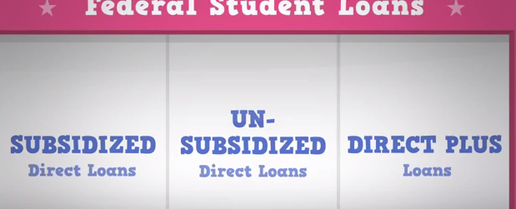
Video: Types of Federal Loans
Click on the image to access the video
1/3 of the class listen for what subsidized loans are
1/3 of the class listen for what unsubsidized loans are
1/3 listen for what direct plus loans are
Everyone should be prepared to share their answers

Slide 15
Whole Group Discussion
What are subsidized loans?
What are unsubsidized loans?
What are Direct Plus loans?

Slide 16

Federal Loans
Subsidized loans postpone the student’s interest obligation as long as they are in college at least half time.
Unsubsidized loans incur interest charges while the student is in college.
Direct Plus loans can be taken out by parents.

Slide 17

More on Loans
Private banks will make loans as well, but usually they have higher interest rates, need to be repaid while the student is in college, and can be harder to get.

Slide 18
Good to Know
You pay a price (interest) for the right to borrow the loan money and end up paying back more than the actual amount of the loan.
Low interest rates can save students thousands of dollars.

Slide 19
Good to Know
Talk with your school counselor for help with all different types of financial aid, including loans.
The shorter the time period for repayment, and the lower the interest rate, the less additional expense to the borrower–the student.

Slide 20
Final Thoughts . . .
Not everybody needs loans, but sometimes students’ financial needs change while in college, so it is good for everyone to know about the options.
School counselors are a great resource for more information. Once you are accepted to a college, the financial aid office at that school can assist as well.

