Slide 1


Filling Out the FAFSA 12th Grade
Learning Target: The students will know what the FAFSA is and what types of information are needed to complete it.

Slide 2

The FAFSA
Not everybody needs financial aid, but most do at some point in college, so it is good to know how to fill out the FAFSA.
As its name indicates, the Free Application for Federal Student Aid is free.

Slide 3

The FAFSA
The size of a family and age of a student’s parents are part of the mathematical calculation.

Slide 4

The FAFSA
Some schools will not consider applicants for any scholarships unless they complete the FAFSA.
School counselors are a great resource for more information, and once students are accepted into a college, the college’s financial aid office can assist as well.

Slide 5

We will watch a series of four videos that will help you learn the different components of the FAFSA form.
It is a lot of information. Try to not get overwhelmed.

Slide 6
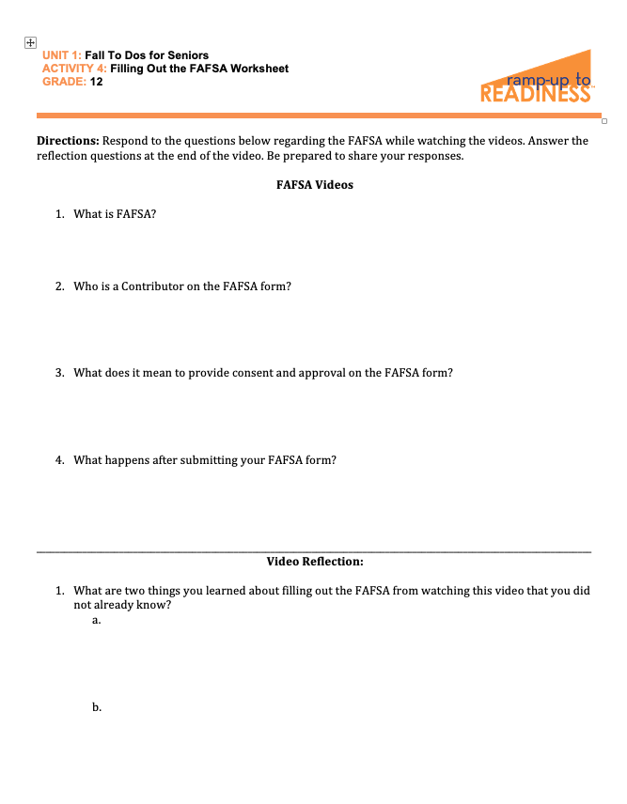
Worksheet
Fill out the worksheet while watching the videos. Be prepared to share after each video.

Slide 7
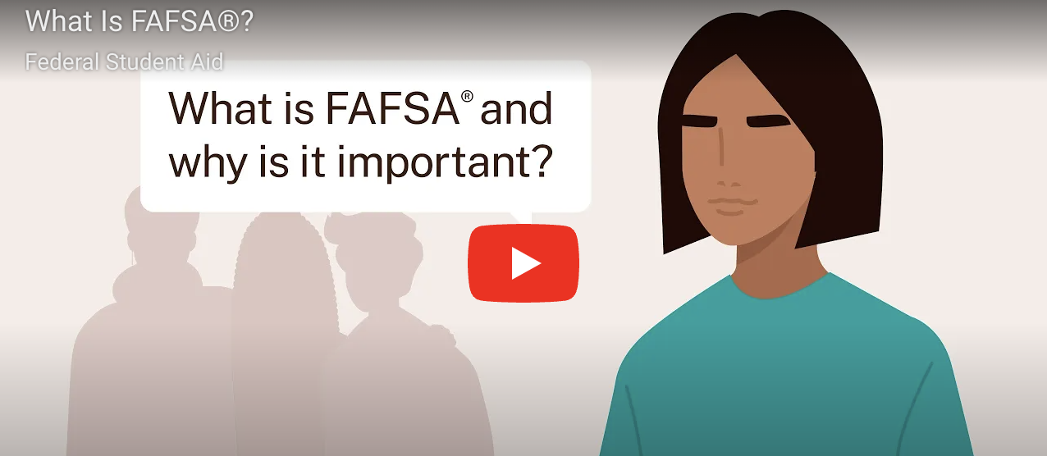
Video: What is FAFSA?
Click on the image to access the video

Slide 8
Share Your Response After Each Video

Slide 9

What is the FAFSA?

Slide 10
What is the FAFSA?
The FAFSA form is the application that students complete each year to receive student aid for college or career school.
It typically takes less than one hour to complete.
The form is used to determine eligibility for federal student aid. Many states will use the same information to determine eligibility for state financial aid.
Financial aid may include grants, scholarships, work study, and student loans.
You can list up to 20 schools. Each school will use the information to determine financial aid.
The FAFSA must be completed every year.

Slide 11

Video: Who Is a Contributor on the FAFSA Form?
Click on the image to access the video

Slide 12
Who is a contributor on the FAFSA form?

Slide 13
Who is a contributor on the FAFSA form?
Anyone required to provide information, consent and approval, and a signature on the FAFSA form is a contributor.
Tax information will be transferred directly from IRS to FAFSA form.
A contributor may include:
Student (you), student’s spouse, biological or adoptive parent, or stepparent
Contributors are determined by dependency, tax filing, and marital status.
Being identified does not mean those listed are financially responsible.

Slide 14

Video: What does it mean to provide consent and approval on the FAFSA?
Click on the image to access the video

Slide 15
What does it mean to provide consent and approval on the FAFSA form?

Slide 16
What does it mean to provide consent and approval on the FAFSA form?
Contributors (including you) are agreeing to:
Share your personally identifiable information provided on the FAFSA form with the IRS
Have your federal tax information transferred into the FAFSA form
Allow U.S. Department of Education to use your federal tax information to determine aid eligibility
Allow the U.S. Department of Education to share your federal tax information with schools listed on your FAFSA form and state higher education agencies
Allow the U.S. Department of Education to reuse your federal tax information on other FAFSA forms you’re invited to and choose to participate on
Consent and approval is required to receive federal student aid.

Slide 17
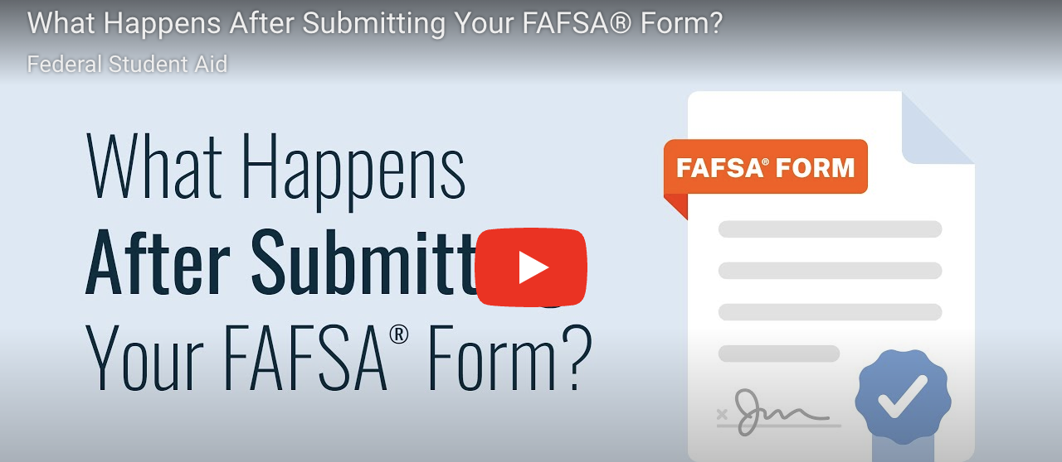
Video: What Happens After Submitting Your FAFSA??
Click on the image to access the video

Slide 18
What happens after submitting your FAFSA form?

Slide 19
What happens after submitting your FAFSA form?
You will receive a confirmation email. This may include your estimated Pell Grant and your estimated Student Aid Index (SAI).
SAI is an index number calculated using your FAFSA information to determine eligibility for need-based aid.
Information is shared with your listed schools to determine financial aid.

Slide 20

More FAFSA Tips
There are scam websites and services that charge to complete the FAFSA–and that they should absolutely not use them. Always go to fafsa.gov.
This FAFSA website is available in English and Spanish.
There is an app!

Slide 21
More FAFSA Tips
Each year there is an updated FAFSA, and the new one is typically available in October for the following year. The federal government recommends that students complete the FAFSA as soon as possible after the release date.

Slide 22
More FAFSA Tips
Families will need to create their own account and provide approval and consent to transfer federal tax info onto the FAFSA form
Some schools have deadlines for financial aid considerations. Earlier is better. Pay attention!

Slide 23
More FAFSA Tips
There are some restrictions on eligibility for federal aid.
Citizens and permanent residents are eligible, and students in the United States on certain other categories of visas are also eligible. “Dream Acts” in some states have expanded eligibility.

Slide 24
More FAFSA Tips
The first step is to apply for the FSA ID. This can be done a few days ahead of completing the FAFSA, to make sure the FSA ID has been received. Contributors will need their own account.

Slide 25
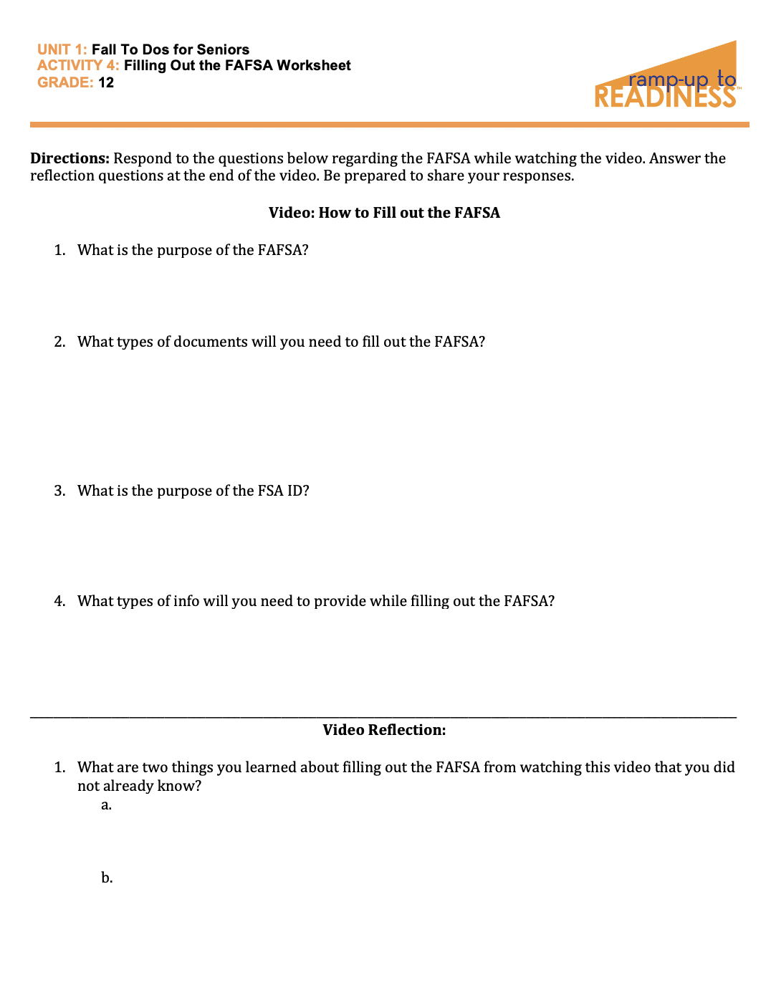
Whole Group Dialogue
Share your answers to the two reflection questions at the bottom of your worksheet.

Slide 26

Good to Know
Once the FAFSA is submitted, you will be emailed a report that summarizes everything you entered on the FAFSA.
You and your family should review it for accuracy. It will include the Student Aid Index, but not how much financial aid you will receive.

Slide 27
Good to Know
Only colleges to which you are accepted, and have listed on the FAFSA, will send award letters with detailed offers of financial aid.

Slide 28

Wondering if you are eligible?
If you have questions about your eligibility, go to https://studentaid.gov/understand-aid/eligibility

Slide 29

For additional guidance:
Check out these other FAFSA videos. The playlist includes the following videos:
Start Your 2025-26 FAFSA Form
Complete the Personal Circumstances and Demographics Sections of the FAFSA Form
Complete the Financials Section of the 2025-26 FAFSA Form
Select Schools To Include on Your 2025-26 FAFSA Form
Review, Sign, and Submit

Slide 30

Final Thoughts . . .
Although the form can look daunting, there are detailed guides, a customer service number to call, and videos on the FAFSA website.
Consider sharing the videos we watched today with your families! They will want—and need—the info you are learning.
You can do this! Do not let your family finances be the reason you do not go to college.

